Slide 1

E Safety workshop
June 2023

Slide 2
Statistics
Children and young people are online more than ever before. In fact, 7-16-year-olds who use the internet say that they spend almost four hours a day online (Childwise, 2021).
Plus, half of ten-year olds now own their own smartphone (Ofcom, 2019)

Slide 3
Talking about E Safety
Start early
Engage
Encourage them to share with an
Adult
Talk about online safety
You can find more information
about having a conversation with
your children on barnados safety hub.

Slide 4
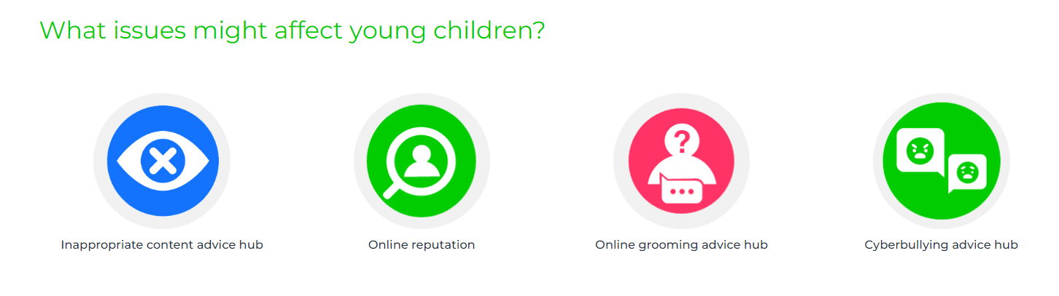
Issues that might arise

Slide 5
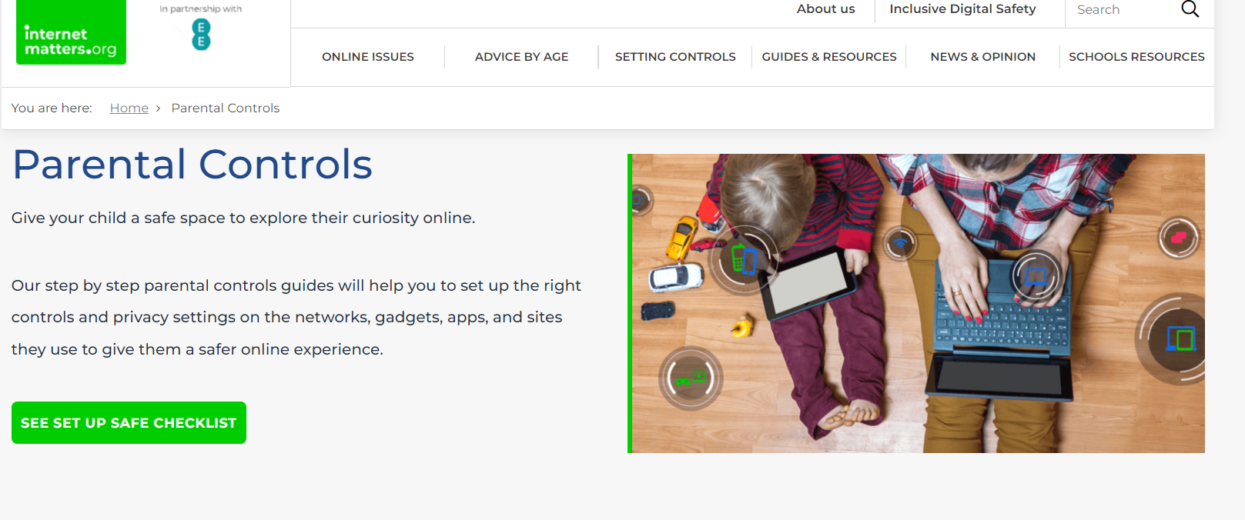
Parental Controls
Most Wi-Fi services, devices and apps have parental controls that you can use for free
https://www.internetmatters.org/parental-controls/
Supporting young children (6 -10s) online | Internet Matters – YouTube video to watch

Slide 6

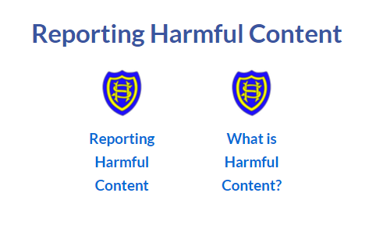




Where to seek help
Report harmful content button on website
E-Safety Support for Parents and Carers | St Helen's Catholic Infant School (st-helens-inf.essex.sch.uk)
Parents and carers | CEOP Education (thinkuknow.co.uk)
Support the NSPCC | NSPCC
Parent Zone | At the heart of digital family life
Samsung Kids - Parental controls | Internet Matters
Parents: Supporting Young People Online (Leaflets) | Childnet

