Slide 1
Phonics is:
making connections between the sounds of our spoken words and the letters that are used to write them down.
Notes:
Slide purpose:
To give a simple definition of phonics
Suggested script:
Read the slide.
It sounds complicated but it really isn’t!
Let's review some of the important words that will help you understand phonics ...

Slide 2
Terminology
phoneme
split vowel digraph
grapheme
blend
digraph
segment
trigraph
Notes:
Slide purpose:
To give simple definitions of key terminology
Suggested script:
Review what each word means – use the Glossary to help.

Slide 3
All the different ways to write the phoneme /sh/:
shell
chef
special
caption
mansion
passion
Notes:
Slide purpose:
To show the different ways of saying the sound /sh/
Suggested script:
This is an example of a sound that can be written in many different ways.
Read the words and highlight the /sh/ graphemes.
Children will learn all of these graphemes in their phonics lessons.

Slide 4
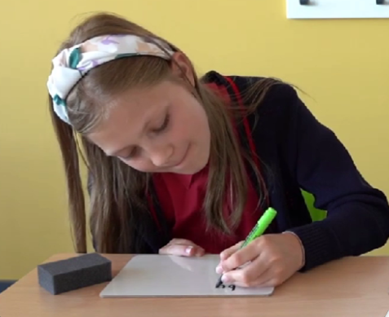
Spelling
Say the word.
Segment the sounds.
Count the sounds.
Write them down.
Notes:
Slide purpose:
To introduce spelling
Suggested script:
Model the process above on a flipchart for the parents to see.

Slide 5
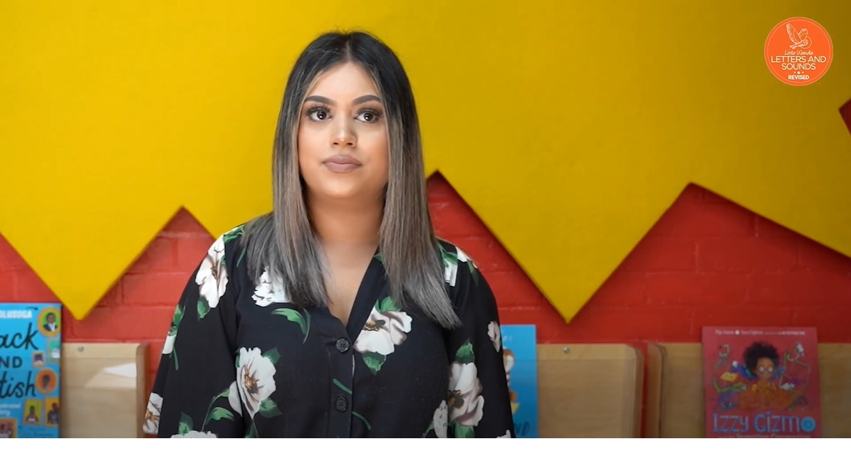
Pronunciation of Sounds Ph 5 (2 Mins)/ How we teach (2 mins)/ Tricky words (3 mins)
Notes:
Slide purpose:
To introduce tricky words
Suggested script:
So, what are tricky words?
Have a look at the ‘How we teach tricky words’ video on the website: https://www.littlewandlelettersandsounds.org.uk/resources/for-parents/

Slide 6



How do we teach reading in books?
Reading practice sessions:
Notes:
Slide purpose:
To introduce decodable readers

Slide 7

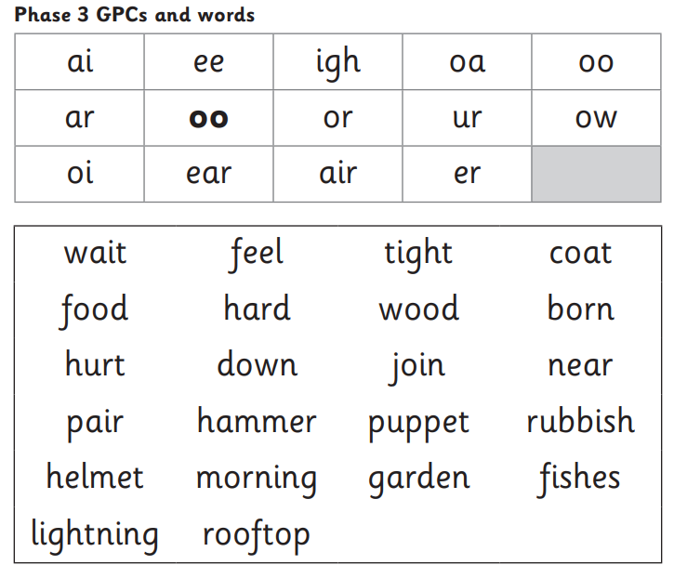


We use assessment to match your child’s reading the right level of book
Notes:
Slide purpose:
To introduce book matching
Suggested script:
We assess your child regularly to check progress.
Any child who needs extra support has Daily Keep-up sessions planned for them.

Slide 8
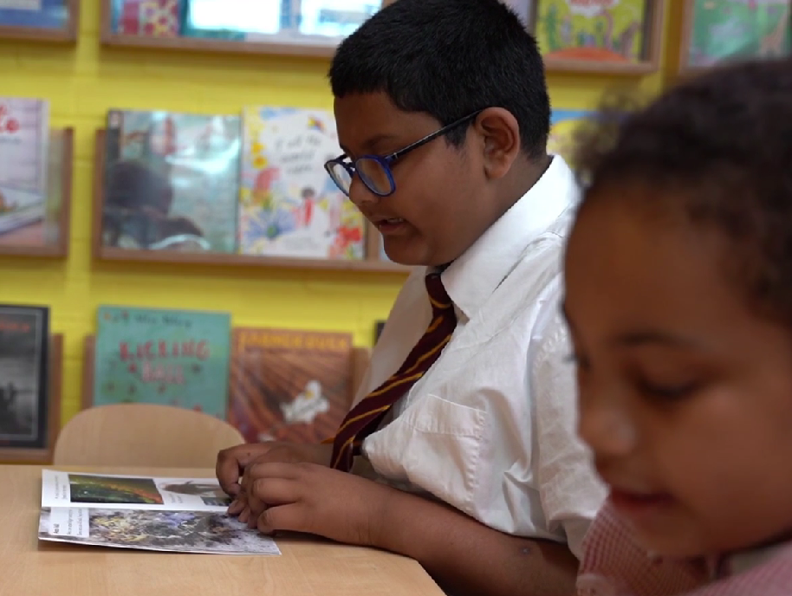
Reading a book at the right level
This means that your child should:
know all the sounds and tricky words in their phonics book well- fluency
read many of the words by silent blending (in their head) – their reading will be automatic
only need to stop and sound out about 5% of the words by the time they bring the book home – but they should be able to do this on their own.
Notes:
Slide purpose:
To provide an overview of book matching.
Suggested script:
Blending in your head means children say the sounds quietly in their heads and then read the whole word out loud. Eventually, this will become automatic and children can read words that they know fluently.

Slide 9

Reading at home

Slide 10

The most important thing you can do is read with your child
Reading a book and chatting had a positive impact a year later on children’s ability to…
understand words and sentences
use a wide range of vocabulary
develop listening comprehension skills.
Read guided and library book at home
Notes:
Slide purpose:
To introduce the values of reading at home
Suggested script:
You play a crucial part in your child's reading and the most important thing you can do is read with them.
Read the slide.
Celebrate child’s success at school.
Make time for reading at home!

Slide 11
Listening to your child read their book
Your child should be able to read their book without your help.
If they can’t read a word, read it to them.
Talk about the book and celebrate their success.
Go through the book talk questions at the back of their fluency books
Notes:
Slide purpose:
To provide guidance on reading the decodable reader at home
Suggested script:
Your child will bring home their phonics book, matched to their reading ability, which they will have already read in school.
The purpose of this book is to practise their fluency.
If your child is finding a word hard to read, encourage them to sound and blend.

Slide 12

Read to your child
The shared book is for YOU to read:
Make the story sound as exciting as you can by changing your voice.
Talk with your child as much as you can:
  Introduce new and exciting language.
  Encourage your child to use new vocabulary.
  Make up sentences together.
  Find different words to use.
  Describe things you see.
Notes:
Slide purpose:
To provide guidance on reading the shared book at home
Suggested script:
Reading to your child daily can open a variety of doors to your child's education, imagination and well-being.
Read the slide.
As a school, we also prioritise reading to the children daily to encourage the love of reading.

Slide 13
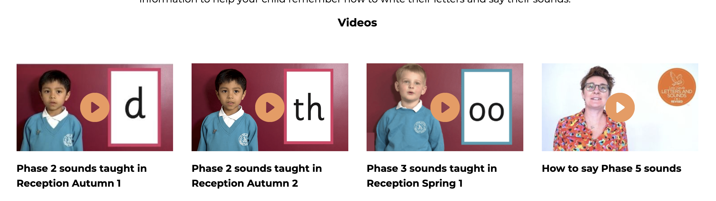
Supporting your child with phonics https://www.littlewandlelettersandsounds.org.uk/resources/for-parents
Notes:
Slide purpose:
Guidance on supporting phonics learning at home
Suggested script:
It is really important that you pronounce the sounds correctly at home if you are supporting your child.
These videos are on the website for you to refer to and if you are unsure, please ask your child’s teacher.
Show the parents where to access the videos on the website and play them. https://www.littlewandlelettersandsounds.org.uk/resources/for-parents/
Tell the parents that ‘Little Wandle at Home’ phonics flashcards are available from HarperCollins: https://collins.co.uk/pages/little-wandle-at-home

Slide 14

You still have an important role to play in supporting your child to become a lifelong reader.
Continue to listen to your child read (reading with your child).
It will support them to develop their reading fluency, their prosody, and their confidence.
Notes:
Slide purpose:
To reinforce the values of reading at home
Suggested script:
Read the slide.

Slide 15
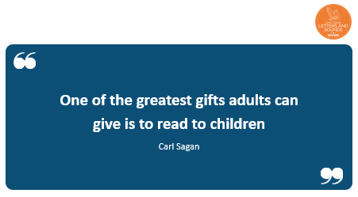
One of the greatest gifts adults can give is to read to children
Carl Sagan
Notes:
Slide purpose:
Key takeaways/final message
Notes:
Read the quote.

