Slide 1
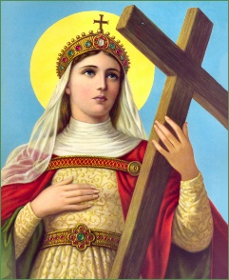
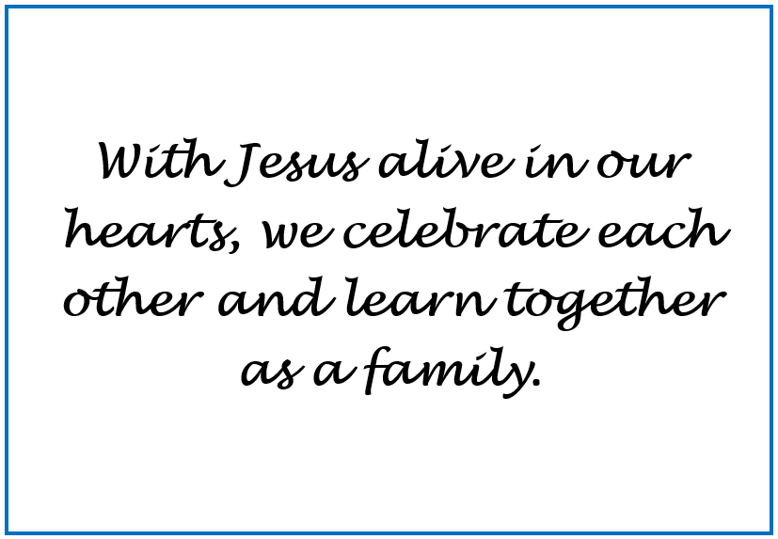
Welcome to Year 2
2025-2026

Slide 2
Staff
2S
Teacher – Mrs Simmons
LSA –Mrs Guy
2B
Teacher - Mrs Boness
LSAs – Mrs Cavanagh/ Mrs Cariolan

Slide 3
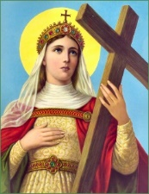
Attendance
At St Helen’s Catholic Infant School, we believe in developing good patterns of attendance to ensure children reach their full potential. Children with highest percentages of attendance and punctuality do better academically than those with low percentages of attendance and punctuality.
Legal expectation: 96%+
At St Helen’s Catholic Infant School
Classes compete for the highest attendance and this is celebrated in the weekly newsletter
Attendance and punctuality is recorded and discussed at Parent Consultations each term
Attendance is recorded and commented on in children’s end of year reports
When children’s attendance/punctuality drops below:
A letter is sent home each term to inform parents of the drop in attendance, where necessary
If there is no improvement, parents are invited to a meeting with the Headteacher and an action plan is created
If there is still no improvement, the local authority are contacted and parents are invited to meeting with the Attendance Officer to discuss ways to improve attendance
Unauthorised absence may result in the school referring to the Local Authority for sanctions and/or legal proceedings
Please Note: The Headteacher refers to the Attendance Policy when responding to all applications for Leave of Absence. This is available via the website: Key Information – Policies – Attendance Policy 2025-2026
/

Slide 4
Behaviour
The behaviour of the children plays an important role in our school community and consistently good behaviour is expected.
Therefore, the peg system continues in Year 2. If they do something outstanding, their peg moves up to the Golden Face and they are given a Golden Face sticker for all to see, plus they earn a house point. If their peg moves down to the pink or the blue sad faces, they are able to improve their behaviour that day to move their peg back up. All pegs are returned to the yellow face each morning.
In each class the children can earn rewards such as stickers and house points.
When the whole class works well together as a team they earn cubes.
25 cubes = class treat which the children choose!
Behaviour Policy is available vis school website: Key Information – Safeguarding and E-Safety – Safeguarding and E-Safety Policies and Information

Slide 5
Year 2 Routines/Curriculum
Each day, the children participate in prayer four times a day.
They take turns to be the class Prayer Leader in their class. They will also participate in collective worship assemblies with the rest of the school.
Two children from each class are the daily helpers and help around the classroom with various tasks. They are also the playground Friendship Buddies that day.
The children have a broad and balanced curriculum, including an English, Maths and Reading session every day.
Every week they have 2 RE lessons and 2 PE lessons.
They also have a weekly Science, PSHE, ICT, Art or D.T., Music and Humanities (History or Geography) lesson.
Each week you can keep up with what your child is learning via the year group page on the website: Children – Year Group Pages – Year 2 – Year 2 Weekly updates on Learning 2025-2026
This year’s Curriculum Map can be found on the website: Key Information – Curriculum – Curriculum Information 2025-2026 – Year 2 Curriculum Map

Slide 6

RSHE
What is it about?
•Came into effect in September 2020
•20 years since the last review of the curriculum – the world has changed
•Relationships Education and Health Education in primary schools
•This guidance is for all primary schools including academies and faith based schools.
What is the purpose of our RSHE curriculum?
We want to enable children to embrace the challenges of creating a happy and successful adult life by equipping them with:
•the knowledge to make informed decisions about their wellbeing, health and relationships
•the opportunity to put knowledge into practice as they develop the capacity to make sound decisions when facing risks, challenges and complex contexts.
•recognition that everyone faces difficult situations in their lives – how can we support children to develop resilience, to know how and when to ask for help, and to know where to access support.
It is taught throughout other subjects: PSHE/ICT/Science/PE/DT and Relationships Education is taught through Journey in Love Scheme.
More detailed information can be found via the website: Key Information – Curriculum – RSHE Information for parents.

Slide 7
Reading
During their reading sessions, each child will complete a reading related task.
They should always have 3 books in their book bag:
Their Little Wandle Guided Reading book.
They will also swap their 2 class library books if they wish to.
Please make a note in their yellow diary each time you hear your child read. Only reading related messages go in the yellow diary.

Slide 8
Reading Race
Please write a short comment in their yellow diary every time you hear your child read
- even if its just the title and the page numbers read.
1 comment from you = 1 move along their class Reading Race.
5 comments = Winning Place + a reward!

Slide 9
Homework
Reading/ Yellow Reading Diary.
We expect the children to read each night. Once they reach Year 2 Fluency level, as well as reading, they will have a comprehension task to complete. Your child will be given a blue homework book to complete the comprehension task in for the following week.
The Homework Policy
15 minutes of reading per evening.
Every Friday
Up to 10 spelling words - either HFW, topic words or grammatical rules.
Weekly homework parentmailed out

Slide 10
Optional SATS
By the end of the year:
Reading – They need to be reading most words accurately without overt sounding and blending, and sufficiently fluently to allow them to focus on their understanding rather than on decoding individual words, check the text makes sense to them, correcting any inaccurate reading, answer questions and make some inferences and explain what has happened so far in what they have read.
Writing – They need to be able to write coherent sentences with conjunctions and adjectives. Handwriting should be legible and they should start using some of the diagonal and horizontal strokes needed to join letters. Spelling of common words needs to be correct and phonetically plausible for words they have not yet learnt.
Maths – They need to be able to have number knowledge and understand place value, be able to use the 4 operations , use simple fractions and measurements and understand the properties of shape, position and direction and have a simple understanding of statistics.
Science – They need to be able to ask simple questions, observe closely , carry out simple tests, gather and record data , identify and classify .
We have some examples of the levels that are expected.

Slide 11



Wellbeing
Where children need additional support with their wellbeing:
‘Colour Monster’ in class
‘Rainbows’ – please see McAuliffe/Mrs Morris

Slide 12
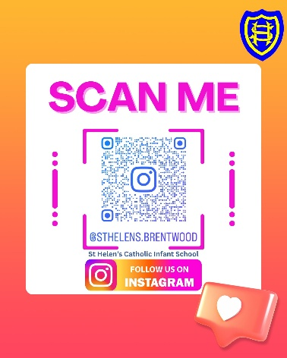
Finally
PE Days - 2S Monday / Friday 2B Monday /Friday
School trips – Pantomime Wed 3rd December 2025
Thriftwood Wed 29th April 2026
Communication: Year group email address year2@st-helens-inf.essex.sch.uk (we will respond within 24 hours during the working day/term time only)
School Newsletter emailed to parents every Friday
School website https://www.st-helens-inf.essex.sch.uk/
Instagram/Facebook
Autumn Term Dates
Class Celebration of the Word Dates – 2S Tues 30th Sept/ 2B Tues 23rd Sept
Parent Consultation evening dates- Tues 21st Oct & Thurs 23rd Oct onsite or via telephone
Y2 Traditional Nativity- Friday 12th Dec
PowerPoint is available on the school website: Key Information-Curriculum-Curriculum Information Evening for Parents 2025-2026

