Slide 1
Phonics is:
making connections between the sounds of our spoken words and the letters that are used to write them down.
Notes:
Slide purpose:
To provide a simple definition of phonics
Suggested script:
So what is phonics?
Read the slide.
It sounds complicated but it really isn’t!
Let's learn some important words that will help you understand phonics ...

Slide 2
Terminology
Phoneme
Blend
Grapheme
Segment
Digraph
Trigraph
Notes:
Slide purpose:
To give simple definitions of key terminology
Notes:
Explain what each word means – use the Glossary to help.

Slide 3
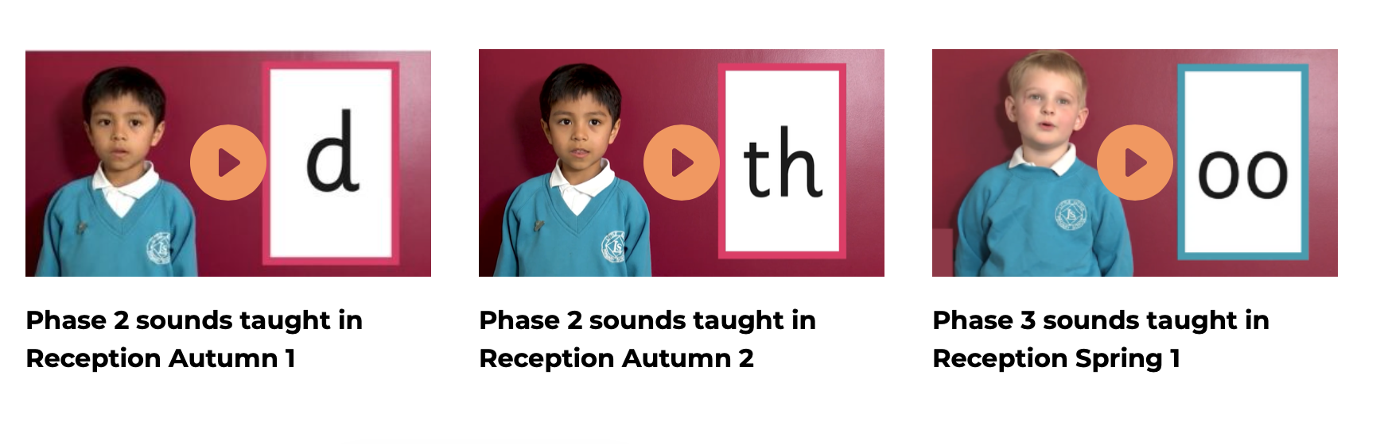
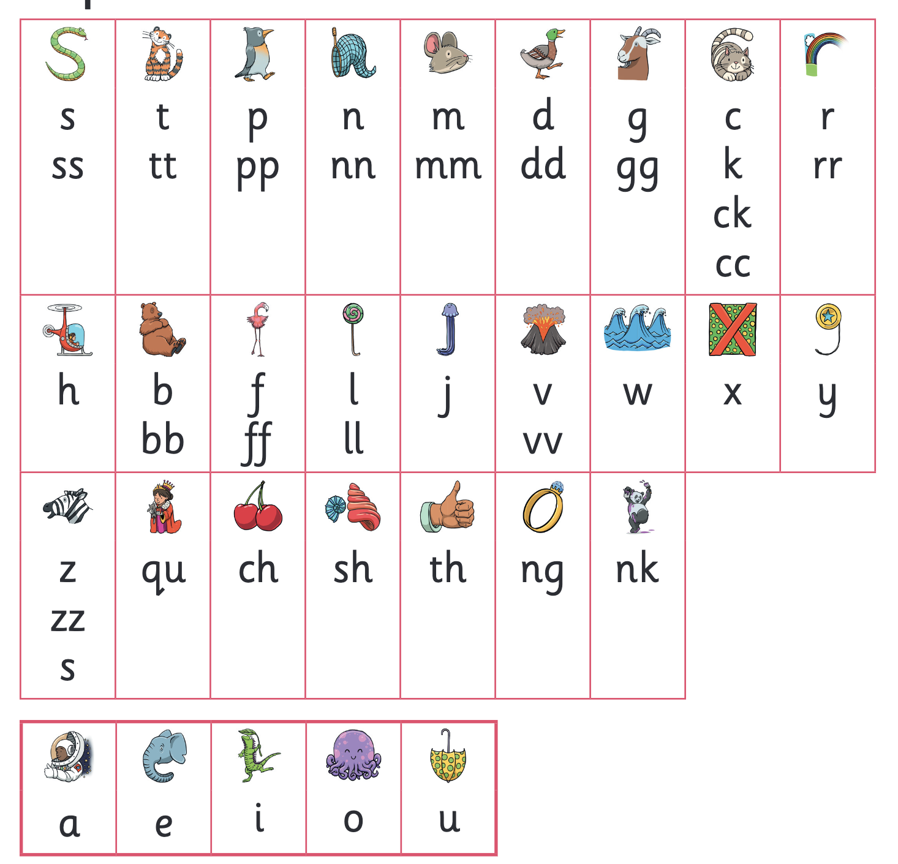
Let’s say the Phase 2 sounds- watch video 2 mins
Notes:
Slide purpose:
To practise the Phase 2 sounds
Notes
Give out the parent handout and the Phase 2 and 3 grapheme mat.
Play the videos/teach the parents to say the Phase 2 sounds: https://www.littlewandlelettersandsounds.org.uk/resources/for-parents/
Show parents where to access these videos in the ‘For parents’ area of the Little Wandle website.

Slide 4
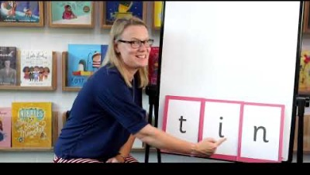
Blending to read words- watch video 2 mins
Notes:
Slide purpose:
To provide an overview of blending
Suggested script:
Some children learn to blend really quickly, and others take a little longer.
If your child is finding it difficult, ask your child’s teacher for ways to help at home – playing blending games at home is so helpful!
Show parents the ‘How we teach blending’ video from ‘For parents’ area of the website: https://www.littlewandlelettersandsounds.org.uk/resources/for-parents/

Slide 5
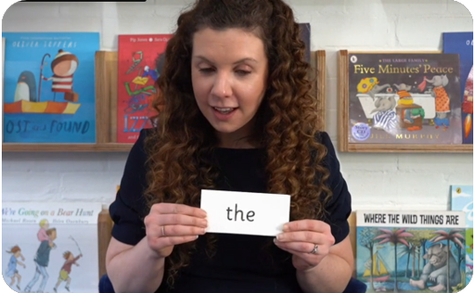
Tricky words- watch video 2 mins
These words have unusual spellings e.g. he, the, was.
They are taught in a systematic way.
Children are now learning to read the Phase 2 tricky words: is, I, the, put, pull, full, as, and, has, his, her, go, no, to, into, she, push, he, of, we, me, be.
Notes:
Slide purpose:
To introduce tricky words
Notes:
Read the slide.
You may wish to give parents a copy of the document ‘Phase 2 tricky words: Reception Autumn term – Information for parents and carers'.

Slide 6
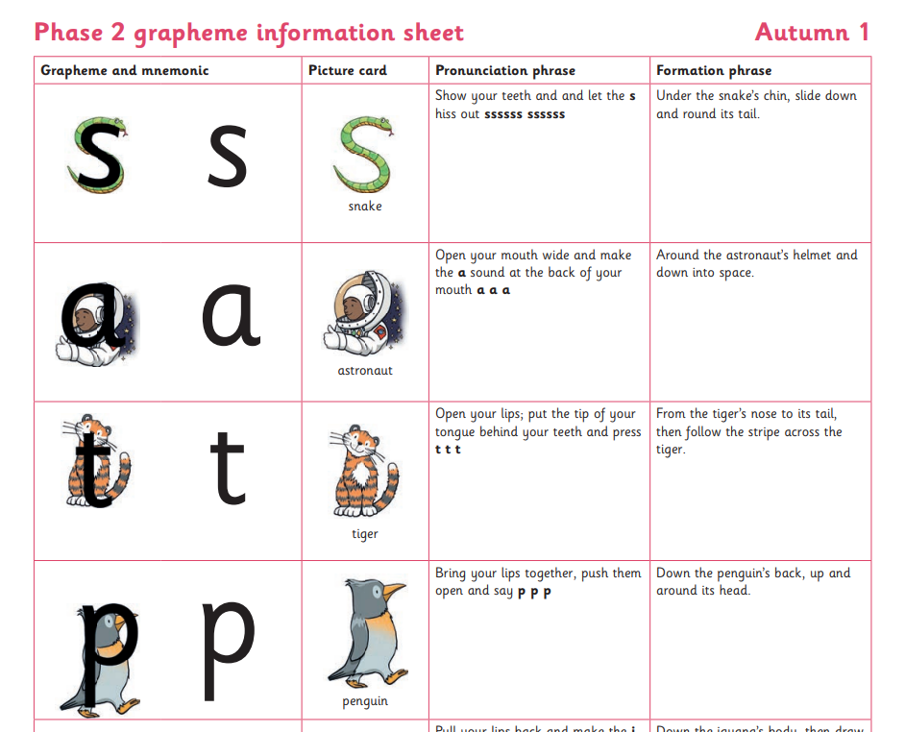

Spelling
Your child will be taught how to spell simple words, using the graphemes they have been taught.
They will practise the correct formation of letters. They will also have handwriting lessons.
Notes:
Slide purpose:
To introduce spelling
Notes:
Read the slide.
Hand out the Phase 2 grapheme information sheet for Autumn 1, which includes the formation phrases.

Slide 7

How do we teach spelling?
Say the word.
Segment the sounds.
Count the sounds.
Write them down.
Notes:
Slide purpose:
To provide an overview of spelling
Notes:
Model the process above on a flipchart for the parents to see.
Show the process with a Phase 2 word, e.g. pin, dig, hug.

Slide 8
How do we practise reading in books?
Reading practice sessions are:
taught by a trained teacher/teaching assistant
taught in small groups
Notes:
Slide purpose:
To introduce decodable books
Suggested script:
The children read the same book three times in a week.
The first time we work on decoding (sounding out) the words, the second time we work on prosody which is reading with expression – making the book sound more interesting with our story-teller voice or our David Attenborough voice – and the third time we look at comprehension.
We read the books three times at school because we want to develop the fluency.
The more children see words, the more they begin to read them automatically without having to sound them out.

Slide 9
Listening to your child read their phonics book
Your child should be able to read their book without your help.
They might sound out words and blend them before they read them fluently.
If they can’t read a word, read it to them.
Talk about the book and celebrate their success.
Notes:
Slide purpose:
To give guidance on reading the decodable book at home
Notes
Read the slide.

Slide 10

Read to your child
The shared book is for YOU to read:
Make the story sound as exciting as you can by changing your voice.
Talk with your child as much as you can:
Introduce new and exciting language.
Encourage your child to use new vocabulary.
Make up sentences together.
Find different words to use.
Describe things you see.
Notes:
Slide purpose:
To give guidance on reading the shared book at home
Notes:
Read the slide.

Slide 11
Supporting your child with phonics https://www.littlewandlelettersandsounds.org.uk/resources/for-parents
Notes:
Slide purpose:
To give guidance on supporting phonics learning at home
Suggested script:
It is really important that you pronounce the sounds correctly at home if you are supporting your child.
Use the videos we saw earlier for support.

Slide 12
One of the greatest gifts adults can give is to read to children
Carl Sagan
Notes:
Slide purpose:
Key takeaways/final message
Notes:
Read the quote.

