Slide 1
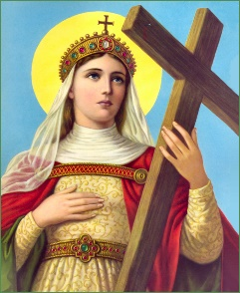


Welcome to Year 1
2026-27

Slide 2
Staff
Class 1M- Miss Maze/ Mrs Scanlon
Class 1Mc- Mrs McCarthy/Mrs Morris
Mrs Cavanagh
Miss Adams
Mrs Guy

Slide 3
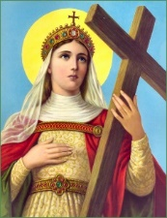
Attendance
At St Helen’s Catholic Infant School and Nursery, we believe in developing good patterns of attendance to ensure children reach their full potential. Children with highest percentages of attendance and punctuality do better academically than those with low percentages of attendance and punctuality.
Legal expectation: 96%+
At St Helen’s Catholic Infant School and Nursery
Classes compete for the highest attendance and this is celebrated in the weekly newsletter
Attendance and punctuality is recorded and discussed at Parent Consultations each term
Attendance is recorded and commented on in children’s end of year reports
When children’s attendance/punctuality drops below:
A letter is sent home each term to inform parents of the drop in attendance, where necessary
If there is no improvement, parents are invited to a meeting with the Headteacher and an action plan is created
If there is still no improvement, the local authority are contacted and parents are invited to meeting with the Attendance Officer to discuss ways to improve attendance
Unauthorised absence may result in the school referring to the Local Authority for sanctions and/or legal proceedings
Please Note: The Headteacher refers to the Attendance Policy when responding to all applications for Leave of Absence. This is available via the website: Parents- Attendance and Punctuality
/

Slide 4
Behaviour
We have high expectations for the children, while recognising some children have specific needs.
We use ‘The Colour Monster’ as the basis for our discussions about feelings and emotions.
We have talked about how we all want to feel calm and that other emotions are just visiting us.
Each class has created a toolkit for the children to use to develop their emotional regulation skills and help them to get back to feeling calm.
The Behaviour Policy is available from school website: Key Information – Safeguarding and E Safety – Safeguarding and E Safety Policies and Information – Behaviour Policy 2026 - 27

Slide 5
Year 1 Curriculum
Each day, the children participate in prayer four times a day.
They take turns to be the class Prayer Leader in their class. They will also participate in Celebration of the Word assemblies with the rest of the school.
Two children from each class are the daily helpers and help around the classroom with various tasks. They are also the playground Friendship Buddies that day.
The children have a broad and balanced curriculum, including an English, Maths, Phonics and Reading session every day.
Every week they have 2 RE lessons and 2 PE lessons
They also have a weekly Science, PSHE, ICT, Art or D.T., Music and Humanities (History or Geography) lesson.
By the end of the year:
Reading – They need to be reading Phase 5 Set 4 by the end of the year fluently and answer comprehension questions about what has been read
Writing – They need to be able to write a sequence of clear sentences with capital letters, full stops and use their taught sounds for spelling
Maths – They need to be able to have an accurate understanding of the place value (tens and ones) of numbers up to 100 and to fluently know all number bonds within 10
Each week you can keep up with what your child is learning via the year group page on the website: Children-Year Group Pages- Year 1
This year’s Curriculum Map can be found on the website: Key Information- Curriculum- Curriculum Information 2026-2027- Year 1

Slide 6

Phonics
Your child will learn to read and write through Phonics. We teach the children phonemes and help them to segment and blend to read words. They apply segmenting skills when writing.
We use Little Wandle Letters and Sounds:
https://www.littlewandlelettersandsounds.org.uk/resources/for-parents

Slide 7
Reading Books
During their reading sessions, each child will complete a reading related task.
They should always have 3 books in their book bag:
Their Little Wandle Guided Reading book.
They will also swap their 2 class library books if they wish to.
Please make a note in their yellow diary each time you hear your child read. Only reading related messages go in the yellow diary.

Slide 8


Phonic Screening
Traditionally Year 1 are formally assessed in their phonics in June.
This year it will take place during June.
We assess the children throughout the year and the Phonic Screening takes an identical format, with your child reading 20 real words on flashcards and 20 fake (‘alien’) words.
Please be assured that this is carried out by a familiar teacher from their year group in a relaxed manner in June 2027. You will probably only know that they have completed it because of the big sticker they come home with!
‘Real’ word flashcards have no picture. ‘Fake’ words have an alien image.

Slide 9
Reading Race
Please write a short comment in their yellow diary every time you hear your child read
- even if its just the title and the page numbers read.
1 comment from you = 1 move along their class Reading Race.
5 comments = Winning Place + a reward!

Slide 10

RSHE
What is it about?
•Came into effect in September 2020
•20 years since the last review of the curriculum – the world has changed
•Relationships Education and Health Education in primary schools
•This guidance is for all primary schools including academies and faith based schools.
What is the purpose of our RSHE curriculum?
We want to enable children to embrace the challenges of creating a happy and successful adult life by equipping them with:
•the knowledge to make informed decisions about their wellbeing, health and relationships
•the opportunity to put knowledge into practice as they develop the capacity to make sound decisions when facing risks, challenges and complex contexts.
•recognition that everyone faces difficult situations in their lives – how can we support children to develop resilience, to know how and when to ask for help, and to know where to access support.
It is taught throughout other subjects: PSHE/ICT/Science/PE/DT and Relationships Education is taught through Journey in Love Scheme
More detailed information can be found via the website: Curriculum- RSHE Information for Parents

Slide 11
Homework
Reading/ Yellow Reading Diary- Discuss the book with your child. Children verbally answer questions about the text they have read.
Homework Policy
Tricky Words–Children should practise their tricky words daily (see inside front cover of reading book).
Spellings –Every Friday, the children will be given up to 5 words to learn. These will either be tricky words, topic words or words based on the phonics learnt in class that week.
Weekly Homework–This will be parent mailed to parents every Friday. It is due in via the year group email on the following Thursday. Instructions will be included in the email about the task.(year1@st-helens-inf.essex.sch.uk)
Weekly Newsletter–Information on current learning and topics is available on the school website: Children –Year Group Pages–Year 1

Slide 12



Wellbeing
Where children need additional support with their wellbeing:
‘Colour Monster’ in class
‘Rainbows’ – please see McAuliffe/Mrs Morris

Slide 13
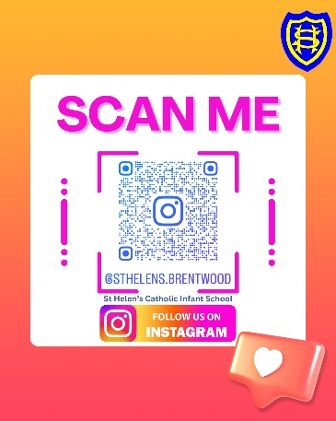
Finally
PE Days Class 1M and 1Mc Thursday and Friday
School trip – Brentwood Theatre -Tuesday 15th December 2026
Barleylands – 10th March 2027
Communication: Year group email address – year1@st-helens-inf.essex.sch.uk (we will respond within 24 hours during the working day/term time only)
School Newsletter emailed to parents every Friday
School website - https://www.st-helens-inf.essex.sch.uk/
Instagram/Facebook
Autumn Term Dates
Parent Consultation evening date (on-site or telephone) 3.30pm-6.30pm - 20th and 22nd Oct
Advent service date (ticketed) – 4th December 2.30pm
Parents/carers will also be invited to Class Liturgies later in the year
Powerpoint is available on the school website: Curriculum- Curriculum Information Evening for Parents 2026-2027

