Slide 1
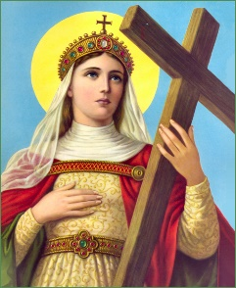


Welcome to Nursery
2026-2027

Slide 2
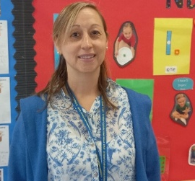
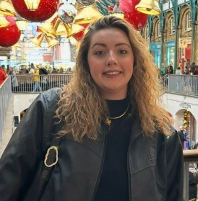
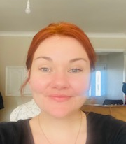
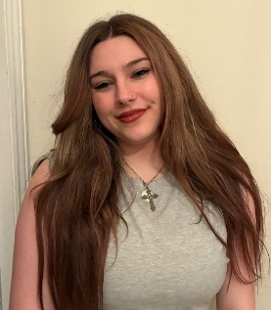
Nursery Staff: 2026-27
EYFS Leader – Mrs Seaman
Nursery Teacher – Miss Adams
EYFS Practitioner – Mrs Beckett
LSA – Miss May

Slide 3
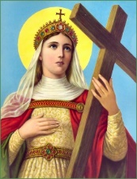
Attendance
Consistent attendance is required to ensure your child gets the best out of their Nursery experience.
If your child is unwell they do need to stay home.
However, regular patterns of absence can result in the government revoking funding and putting your child’s Nursery place at risk.

Slide 4
Behaviour
We have high expectations for the children, while recognising some children have specific needs.
We use ‘The Colour Monster’ as the basis for our discussions about feelings and emotions.
We will be talking as a class about how we all want to feel calm and that other emotions are just visiting us.
Golden Tickets
The Behaviour Policy is available from school website: Key Information – Safeguarding and E Safety – Safeguarding and E Safety Policies and Information – Behaviour Policy 2026 - 27

Slide 5
Routines
Start of day – Self registration, fine and gross motor activities on tables
Prayer
Focused Literacy and Phonic learning
Child initiated and adult-led activities
BREAK
Focused Maths learning
Child initiated and adult-led activities
LUNCH
Focused RE/Understanding the World/PSED input
A mixture of child initiated and adult-led activities
Storytime or Circle time
Getting ready for home time
School finishes

Slide 6
Curriculum
Each area of learning and development is implemented through planned, purposeful play and through a mix of adult-led and child-initiated activities.
RE twice a week; 10% curriculum time
By the end of Reception your child will be assessed against the Early Learning Goals
Reading – They need to be able to read their own name and familiar words.
Writing – They need to be able to write their own name.
Maths – They need to be able to work with numbers up to 10.
Each week you can keep up with what your child is learning via the year group page on the website:
This year’s Curriculum Map can be found on the website.

Slide 7
Reading
Their class library book, which they will swap once a week.
Please make a note in their yellow diary each time you hear your child read. Only reading related messages go in the yellow diary.

Slide 8

RSHE
What is it about?
In nursery and reception classes, the curriculum introduces young children to God's love through physical, social, emotional, intellectual, and spiritual development
The core themes is ‘The Wonder of Being Special and Unique.’
Key Areas of Development in EYFS
Spiritual: Exploring that God loves and cares for each person, and recognizing signs of being loved and kept safe.
Physical: Discovering how everyone is unique and different, naming basic external body parts, and understanding personal hygiene or self-care.
Social & Emotional: Learning how to be a good friend, sharing feelings, and celebrating individual worth and identity.
Intellectual: Discussing why friends are important and understanding what makes a good, kind relationship.
What is the purpose of our RSHE curriculum?
We want to enable children to embrace the challenges of creating a happy and successful adult life.

Slide 9

Tapestry
We take lots of photos, videos and write comments in their books and sometimes on Tapestry.
For example…….
“Mary went to the Challenge Area and counted the bears, she touched them as she counted. Mary was able to count 10 bears accurately and wrote the number 10 on a post it note independently.” (accompanied by a photo)
The benefits of Tapestry are that you can upload photos and videos about children’s learning to share with us too.

Slide 10



Wellbeing
Where children need additional support with their wellbeing:
‘Colour Monster’ in classes
‘Rainbows’ – please see Ms McAuliffe/Mrs Morris

Slide 11
Finally
Nursery trip to Hopefield Animal Sanctuary: Wednesday 10th June 2026
Communication to your child’s teacher: foundation@st-helens-inf.essex.sch.uk
Please name the email Subject; your child’s name and class number.
Will respond within 24 hours (during the working day/term time only).
School Newsletter emailed to parents/carers every Friday
School website is a great place to go if you have any questions: https://www.st-helens-inf.essex.sch.uk/
Instagram – photos/videos of school activities
Autumn Term Dates
Parent Consultation evenings: 20th and 22nd October (on-site or telephone)
Christmas Songs Thursday 17th December at 2:30pm
This Powerpoint is available on the school website: https://www.st-helens-inf.essex.sch.uk/curriculum-information-evening-for-parents-2026-27/

